Slide 1

CSE- 104
Structured Programming Lab
Lab : 02 Loop (Advanced)
Fahad Ahmed
Lecturer, Dept. of CSE
E-mail: fahadahmed@uap-bd.edu

Slide 2
Loop
What will be output of following c code?
#include<stdio.h>
int main(){
int i=2,j=2;
while( i+1?--i:j++ )
printf("%d",i);
return 0;
}

Slide 3
Loop
Output: 1
Explanation:
Consider the while loop condition: i + 1 ? -- i : ++j
In first iteration: i + 1 = 3 (True)
So ternary operator will return -–i i.e. 1
In c 1 means true so while condition is true. Hence printf statement will print 1
In second iteration: i+ 1 = 2 (True)
So ternary operator will return -–i i.e. 0
In c zero means false so while condition is false. Hence program control will come out of the while loop.

Slide 4
Loop
What will be output of following c code? #include<stdio.h>
int main()
{
int i=0;
for( ++i; ++i; ++i )
{
printf("%d ",i);
if(i==4) break;
}
}

Slide 5
Loop
Output: 2 4
initial value of variable i = 0
First iteration:
For loop starts value: ++i, i = 0 + 1 = 1
For loop condition: ++i, i = 1 + 1 = 2 , loop condition is true. Hence printf statement will print 2
Loop incrimination: ++i. i = 2 + 1 =3
Second iteration:
For loop condition: ++i. i = 3 + 1 = 4 . loop condition is true. Hence printf statement will print 4.
Since is equal to for so if condition is also true. But due to break keyword program control will come out of the for loop.

Slide 6
Loop
for (scanf("%d", &n); n != 0; n = n/10) {
s = s + n % 10;
}
Output: ??

Slide 7
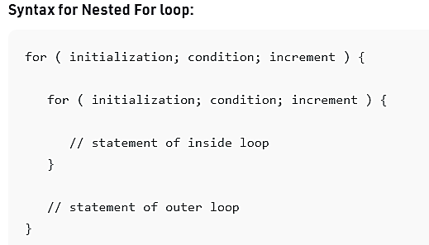
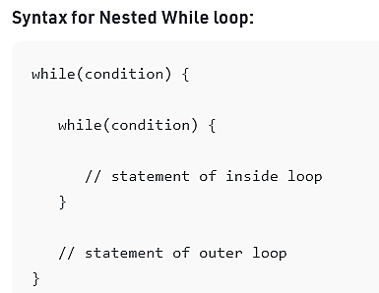
Nested Loop

Slide 8
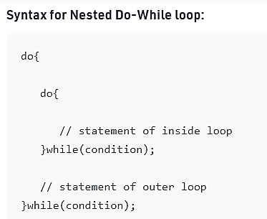
Nested Loop

Slide 9
Nested loop-01
square star pattern
Enter number of rows: 4
****
****
****
****

Slide 10
Nested loop-02
Right triangle star pattern
Enter value of n: 5
*
**
***
****
*****

Slide 11
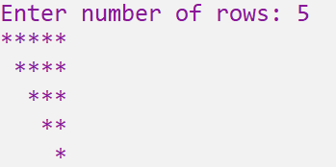
Nested loop-03
Reverse mirrored right triangle

Slide 12
Nested loop-04
Number pattern
Output
1
121
12321
1234321
123454321
Input N: 5
Output
1
121
12321
1234321
123454321

Slide 13
Nested loop-04
Output
1
121
12321
1234321
123454321
Number pattern
1
12-
123--
1234---
12345----
--1 ---21 ----321 -----4321

Slide 14
Test -01 (10 marks)
Time: 25 min
Lab Exam Number (LE) is a number in which sum of factorial of its digits is tantamount to the actual number.
Like: 40585 = 4! + 0! + 5! + 8! + 5!
Write C program to print all LE numbers between 1 to N (max 8 digit)

Slide 15
Test -01 (10 marks)
Time: 25 min
Special number is also known as Krishnamurthy number and Strong number is a number in which sum of factorial of its digits is tantamount to the actual number.
Like: 40585, is a LN. Because,
4! + 0! + 5! + 8! + 5! = 40585
Write C program to print all SS numbers between 1 to N

Slide 16
Test -01 (10 marks)
#include <stdio.h>
int main()
{
int i, ori_num, num, lstdigit, sum;
long fact;
printf("Enter a number ");
scanf("%d", &num);
ori_num = num;
sum = 0;
while(num > 0)
{
lstdigit = num % 10;
fact = 1;
for(i=1; i<=lstdigit; i++)
fact = fact * i;
sum = sum + fact;
num = num / 10;
}
if(sum == ori_num)
printf("%d is LE NUMBER", ori_num);
else
printf("%d is NOT LE NUMBER", ori_num);
return 0;
}

Slide 17

Thanks to All

